Slide 1
Unit 3 lesson 2-5 The Need For Algorithms- Creativity in Algorithms – Simple Commands - Functions
Day 18

Slide 2
Quiz Time

Slide 3
Lesson 2- The Need for Algorithms
Low level programming language: A programming language that captures only the most primitive operations available to a machine. Anything that a computer can do can be represented with combinations of low level commands.
High level programming language: A programming language with many commands and features designed to make common tasks easier to program. Any high level functionality is encapsulated as combinations of low level commands.

Slide 4
Algorithm - A precise sequence of instructions for processes that can be executed by a computer
Iterate - To repeat in order to achieve, or get closer to, a desired goal.
Selection - A generic term for a type of programming statement (usually an if-statement) that uses a Boolean condition to determine, or select, whether or not to run a certain block of statements.
Sequencing - Putting commands in correct order so computers can read the commands.

Slide 5
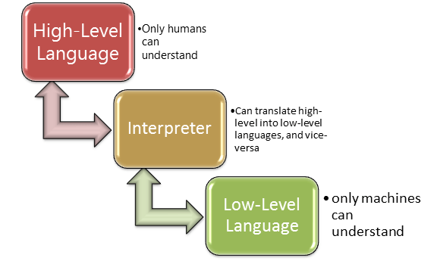

Slide 6
Unit 3 Lesson 4 & 5- Programming With Simple Commands / Creating Functions
Day 26

Slide 7
Tutorial Video
Turtle Programming Video…
Explains the history of turtle graphics and introduction to App Lab

Slide 8
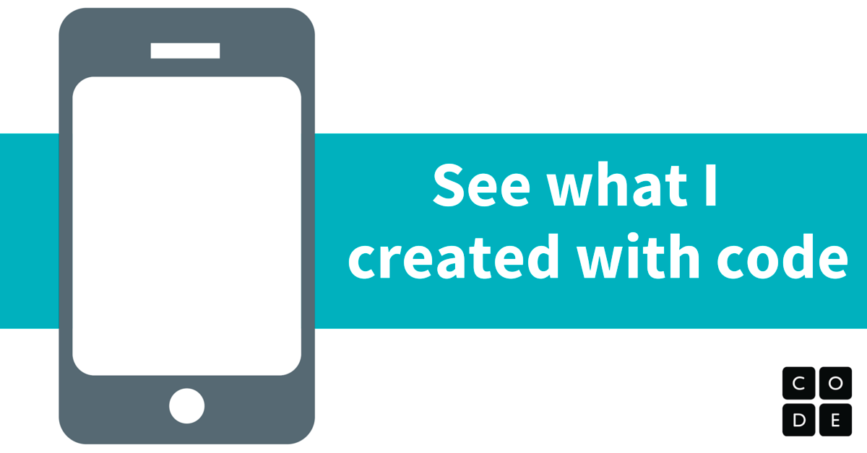
APP LAB
Learn to use the App Lab programming environment
Write a program that uses basic "building blocks" to draw an image in App Lab
Turtle Programming

Slide 9
Complete Lesson 4
Go For it- Lesson 4

Slide 10
Lesson 5- Creating Functions
Tutorial Video: Defining and Calling Functions

Slide 11
Lesson 5- Creating Functions
Write functions with names that describe what each function does in solving the problem.
Write a program that uses more than one function and more than one level of abstraction.

Slide 12
Complete Lesson 5
Go For it- Lesson 5

Slide 13
Review / Next Class
Review
Put JavaScript Commands in Journal
View Socks Video/Article

